Slide 1
Section 1: UDP, TCP, and addresses
CSE 461

Slide 2
Addressing
Project 0 requires sending your own IP address to another client
Problem: getting own IP address can be hard
How can we do it?

Slide 3
Getting own IP address: hostname method
Steps
Python example
Get the computer’s host name
Resolve it into an IP address
import socket
name = socket.gethostname()
ip = socket.gethostbyname(name)
Sometimes doesn’t work depending on hostname configuration and/or will just return local host (127.0.0.1)

Slide 4
Getting own IP address: connect to server method
Steps
Python example
Create a socket
Connect to known server on internet
Get socket address
import socket
s = socket.socket(socket.AF_INET, socket.SOCK_DGRAM)
s.connect((‘gmail.com’,80))
ip = s.getsockname()[0]
Useful when previous method doesn’t work
Similar methods exist for other languages as well

Slide 5
Other Methods
getaddrinfo()
E.g., socket.getaddrinfo(name, 0)
Can return other network interfaces that you don’t want (e.g., IPv6)
Querying outside URL
E.g., urllib2.urlopen(‘http://abstract.cs.washington.edu/~zahorjan/ip.cgi’).read()
Best method (if you have a dedicated server to tell you your IP)

Slide 6
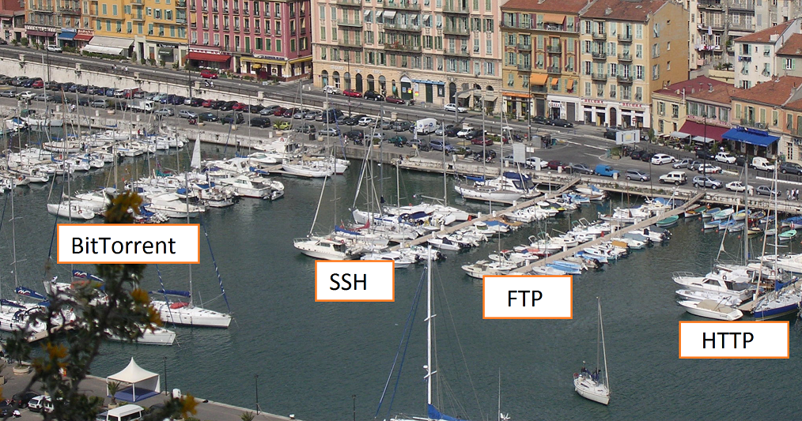
Ports
Addresses specific to applications/services on a system
16-bit numbers (from 0 to 165535)

Slide 7
Well-Known Ports
Many applications/services have designated ports
Examples:
ftp: 21
ssh: 22
telnet: 23
http: 80
Ports from 0 to 1023 are “well-known ports” (don’t use them for protocols you make up!)
Can see a list of your system’s well known ports in /etc/services (Linux/Unix)

Slide 8
Hostnames map to IP addresses
Hosts contact DNS (Domain Name System) servers to get IP address of a given name
E.g., ‘www.gmail.com’ maps to 173.194.33.118
nslookup demo

